Slide 1
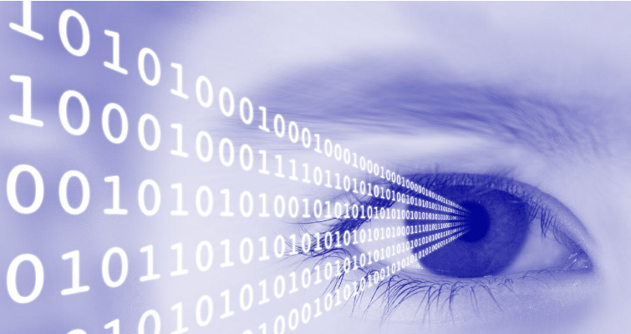
FUNDAMENTALS OF IMAGE PROCESSING
-BATCH 05

Slide 2




TEAM MEMBERS
211FA18003
211FA18004
211FA18028
211FA18049
A.HEMANTH
K.ESWAR
U.SRINIVAS
CH.VARSHA

Slide 3
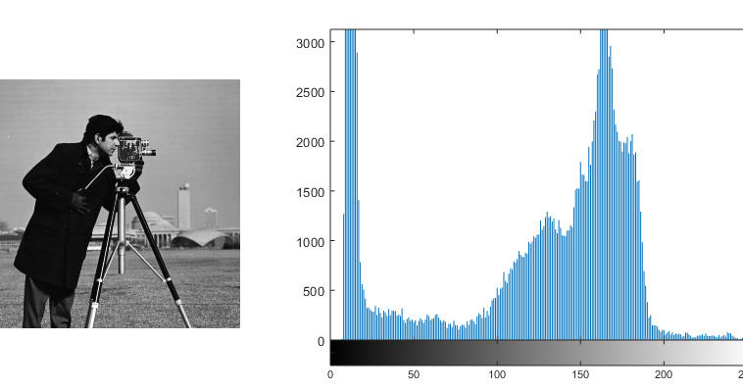
CONTENTS
QUESTION
01
INTRODUCTION
02
SOLUTION
03
HISTOGRAMS PLOTTING
04
CONCLUSION
05

Slide 4
QUESTION
2. Consider 4-bit image of 4x4 dimension and perform the following operations [[10,12,8,9],[10,12,12,14],[12,13,10,9],[14,12,10,12] À)Apply histogram equalization to the image by rounding image pixels to integers.
B) Sketch the histogram of the original image and histogram equalized image.
C) Can you think of scenarios where histogram equalization might not be the most appropriate technique for contrast enhancement?

Slide 5

INTRODUCTION
Histograms of an image are graphical representations of the distribution of pixel intensities within that image. They are often used in image processing and analysis to understand the tonal range, contrast, and brightness characteristics of an image.
In a graph, the horizontal axis of the graph is used to represent gray scale values whereas the vertical axis is used to represent the number of pixels . Black and dark areas are represented in the left side of the horizontal axis.

Slide 6
APPLICATIONS OF HISTOGRAMS
Visualizing data : Histograms can display a large amount of data and the frequency of the data values. They can also show the number of observations that fall within each bin.
Medical Imaging: Histogram analysis is used for tissue characterization, tumor detection, and segmentation in medical images such as MRI and CT scans.
Video Surveillance: Histogram-based tracking algorithms are used to detect and track objects in real-time video streams, aiding in surveillance and security applications.

Slide 7
HISTOGRAM EQUALIZATION
Histogram equalization is a technique used in image processing to enhance the contrast of an image by adjusting the intensity distribution across the histogram. It is basically spreading out the intensity values which is widely used in various applications, including image enhancement, computer vision, and medical imaging, to improve the visibility of details and features in images.
There are two types of histogram equalization:
Global: Enhances the contrast of the whole image
Local: Enhances image details by applying different transformations to the same gray level at different places in the original image

Slide 8
APPLICATIONS OF HISTOGRAM EQUALIZATION
Satellite Imaging: Enhances the quality of satellite images by equalizing histograms to improve the detection of terrain features and land use patterns.
Face Recognition: Histogram equalization enhances facial features in images, facilitating more accurate face recognition in security and authentication systems.
Medical Imaging: Histogram equalization enhances the contrast of medical images, aiding in the visualization of subtle details for diagnosis.
Surveillance Systems: Improves the visibility of objects in surveillance footage by equalizing the histogram to reveal details in low-light or high-contrast scenes.

Slide 9
SOLUTION
A) To perform histogram equalization on the given 4x4 image, we'll follow these steps:
Plot the Histogram of given Image.
Tabulate the gray levels and their intensities in the original Image.
Compute the cummulative sum of the intensity values.
Now divide the cummulative sum with the total no.of pixels .
Multiply the individual result with the Max Gray Level.
Round the equalized intensities to integers.

Slide 10
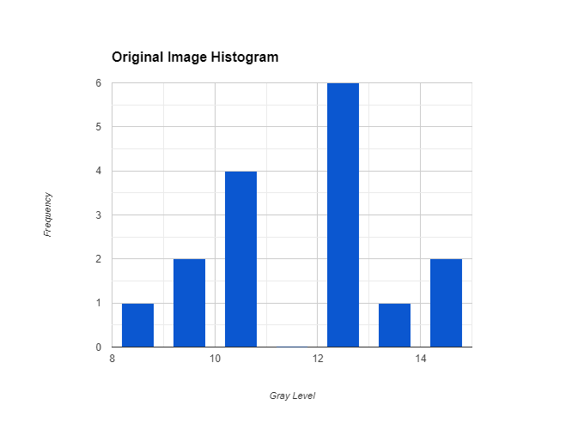
ORIGINAL IMAGE
IMAGE=[ [10, 12, 8, 9],
[10, 12, 12, 14],
[12, 13, 10, 9],
[14, 12, 10, 12] ]
If we plot a Histogram for this , initially
it looks like :

Slide 11
Performing histogram equalization on above image.
Grey levels | 0-7 | 8 | 9 | 10 | 11 | 12 | 13 | 14 | 15
No of pixels | 0 | 1 | 2 | 4 | 0 | 6 | 1 | 2 | 0
Running sum | 0 | 1 | 3 | 7 | 7 | 13 | 14 | 16 | 16
Running sum/Total no of pixels | 0/16 | 1/16 | 3/16 | 7/16 | 7/16 | 13/16 | 14/16 | 16/16 | 16/16
Result * max gray level | 0*15 | 1/16 * 15 | 3/16 * 15 | 7/16 * 15 | 7/16 * 15 | 13/16 * 15 | 14/16 * 15 | 15 | 15
Final Result | 0 | 1 | 3 | 7 | 7 | 13 | 14 | 15 | 15

Slide 12
ORIGINAL IMAGE
IMAGE=[ [10, 12, 8, 9],
[10, 12, 12, 14],
[12, 13, 10, 9],
[14, 12, 10, 12] ]
EQUALIZED IMAGE: IMAGE=[ [7, 13, 1, 3],
[7, 13, 13, 15],
[13, 14, 7, 3],
[15, 13, 7, 13] ]

Slide 13
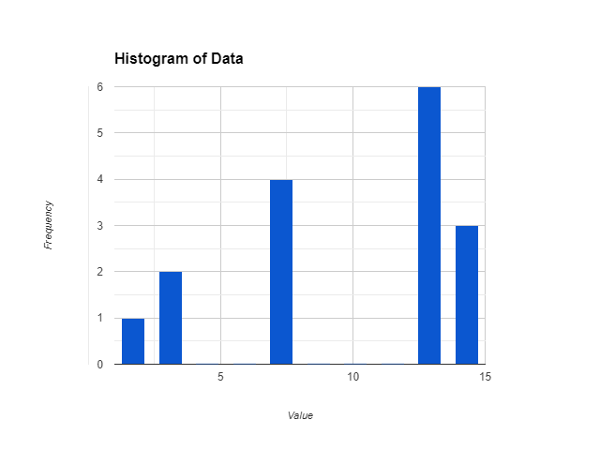

B) Sketching the histogram of the original image and the histogram equalized image would require plotting the frequency of pixel intensities.

Slide 14
C) Histogram equalization might not be the most appropriate technique for contrast enhancement in scenarios where:
Non-uniform Distribution: If the original image already has a relatively uniform distribution of pixel intensities, histogram equalization might distort the contrast and make the image appear unnatural.
Extreme Pixel Values: Histogram equalization can amplify noise in images with extreme pixel values. In such cases, other techniques like adaptive histogram equalization might be more suitable.
Local Contrast Enhancement: Histogram equalization treats the entire image globally. In scenarios where local contrast enhancement is necessary, other

Slide 15
techniques like adaptive histogram equalization or contrast limited adaptive histogram equalization (CLAHE) might be more effective.
4.Computational Cost: Histogram equalization can be computationally expensive, especially for large images or real-time applications. In such cases, faster techniques like contrast stretching or gamma correction might be preferred.

Slide 16
THANK YOU

